Slide 1
Caseworx
IAO Edition
Nelson Mark, nel@jklsoftware.com
JKL Software

Slide 2
Caseworx
Revision History
2015, Mar 26 – v1.0 Initial release
2015, Apr 22 – v1.1 Added new feature information, case types (fellow/diplomate), re-submission feature, tracing+overlay

Slide 3
Caseworx
Overview

Slide 4
IBO Case Presentation Format
Full narrative output
Copies or prints of radiographs
Ceph tracings sets (radiograph, tracing, overlay)
Mounted or grid printed photographs
Boxes of study models or digital model images
IBO Cephalometric Summary

Slide 5
Common Case Problems
Fields left blank
Can’t tell if left out or just plain missing
“Normal” or intentional blank should have something indicating such
“Within normal limits”
“No extraordinary findings”
“Not applicable for this patient”
Missing whole sections of photos or imaging
Should have Pre-Tx, Post-Tx
Post+2 years if applicable
Missing details or items completely

Slide 6
Common Case Problems
Assumption that examiner knows the patient like you do
Narrative does not establish a good picture of patient for examiner
Poor or thin patient history
Should already have data based on actual patient evaluation and management, right?
Missing or incomplete clinical evaluation
Lack of scientific evidence in details
“Patients weight was normal for their age”
“Patient weighed 155lbs, within the normal range for their age”
Not enough details

Slide 7
Common Case Problems
Poor grammar and sentence structure
What is “that” and where is “there”?
Narrate case in neutral viewer position
No: “I saw the patient and she had pain in the left side of her face”
Yes: “The patient presents with a severe case of pain in the left side of her face”
Data in wrong place(s), not in right order
Not formatted to “IBO presentation standard”
Improper formatting, grammar and/or spelling errors

Slide 8
Common Case Problems
Radiographs not clear
Copies/scans not clear, but originals are
Improper items in image
Earrings not removed
Tongue rings present
Poor angulation of image
Landmarks not clearly visible
Landmarks misidentified in ceph
Poor imaging

Slide 9
Common Case Problems
Poorly exposed
Poorly focused
Bad coloration/color casts
Not composed correctly
Patient not looking STRAIGHT AHEAD
Has eyeglasses on
Eyes closed
Shoulders not visible
Image crooked or not level
Missing required images
Poor photographs

Slide 10
Common Case Problems
Rough, not finished cleanly
Bad impression
Improper size, not within IBO standards
Not marked with date or doctors ID
Digital printout not clear
Digital printout not labeled correctly
Poor quality study models

Slide 11
Caseworx
candidate

Slide 12
What Benefits? Why?
Why build a digital case?
How does it help?
Where does it all fit in?
What does it do for me?!

Slide 13
Benefit – Singular Data Fielding
One thought, one answer
Saves each item separately
Easy to spot missing items

Slide 14
Benefit – Auto Output Formatting
Properly orders items
Saved separately from data
Can be manually edited
Can be exported to Microsoft Word

Slide 15
Benefit – Digital Imaging Storage
Saved with case
Labeled and ordered
WSYIWYG for examiner

Slide 16
Benefit – Digital Photo Grids
Saved with case
Labeled and ordered
Grid auto-generated

Slide 17
Benefit – Built-in Image Editing
Non-destructive
Cropping, exposure, color cast removal
Maintains change history

Slide 18
Benefit – To-Do List
Shows missed fields
Auto-generated when refreshing output
Reminds of things to do before submitting case

Slide 19
Benefit – Learn to Collect Proper Documentation
Covers medical necessity for treatment
Provides legal documentation
Consistent, predictable documentation between all cases
Great exercise for daily practice

Slide 20
Candidate Case Process
Create
Gather info
Generate output
Submit
Verify output
Scored
Receive score update
Send to server
Check results and details
Import images
Checklist
Enter details

Slide 21
Caseworx
Installation

Slide 22
Getting Caseworx Package
Download directly from jklsoftware.com
Choose Products -> Caseworx (jklsoftware.com/caseworx)
Free for all IAO members
User manuals, Candidate’s Handbook included with package
Updates are directly checked and installed by the program on start

Slide 23
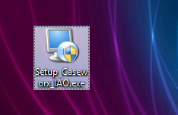
Installing Caseworx Package
Run package downloaded
If computer needs updated, installer will inform and download updates directly from Microsoft website
Cannot install without the updates installed
May need reboot after install. Will notify if needed.

Slide 24
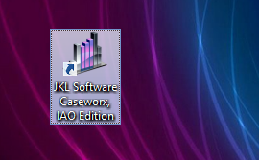
Starting Caseworx on Your Computer
Must have Internet connection on first start – checks for updates and create user account
Double-click icon on desktop or start from Start Menu (JKL Software -> Caseworx)

Slide 25
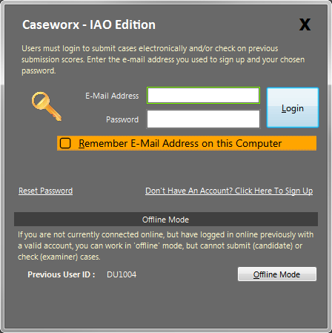
Creating User Account / Logging In
Enter e-mail and password to login, if you have an account already
Create account by clicking on “Don’t Have An Account? Click Here To Sign Up” link

Slide 26
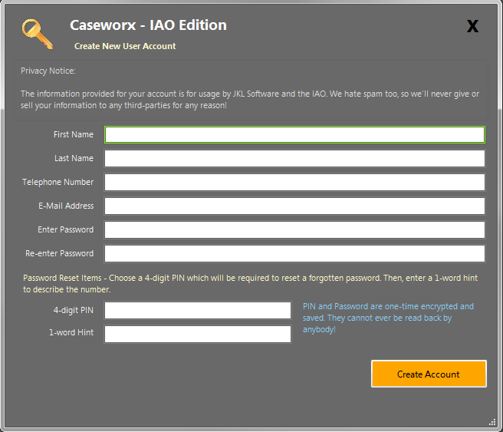
Creating User Account
Enter information to create account
E-mail address used to identify
PIN and hint used to reset password
Passwords are “hashed”, not stored
Cannot be decrypted

Slide 27
Working “Offline”
Allows for cases to be built and worked on without active Internet connection
Once an account created and logged in once (system will remember the last user that logged in)
Doesn’t check submitted cases and score updates
Can login at any time to go “online”

Slide 28
Common Issues
Issue/Symptom
Cause / Solution
Program acts weird
Gets “Access Denied” messages
Images may not save or delete correctly
Local Windows user account does not have enough permissions
Change Windows user account to “Administrator”

Slide 29
Common Issues
Issue/Symptom
Cause / Solution
Text seems too large or cut off in program
Proportions of text odd or off
Most prominent in MacOS installed Parallels or Vmware with “Retina Display” hardware
Windows client is configured for “Custom Text Size” greater than 100% or to odd proportion
Change or reduce the Windows “Screen DPI” or “Custom Text Size”

Slide 30
Common Issues
Issue/Symptom
Cause / Solution
Submitting packages or updating scores seem to take a long time, never complete, or hang the program
Poor or inconsistent Internet connection
Check Internet connection
If wireless, check signal strength
Avoid public Wifi points
Some cellular connections have high latency

Slide 31
Common Issues
Issue/Symptom
Cause / Solution
Program cannot install or update
Windows permissions too restrictive or missing “Administrator” permission
Windows User Access Control (UAC) pop-up authorization window was answered “No” when asking for permission to install or update program

Slide 32
Caseworx
navigation

Slide 33
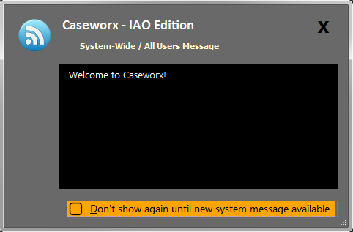
System Message
Shown once on program startup
Announces system-wide messages
System maintenance
Major updates, fixes, changes
Can be hidden until message changes

Slide 34
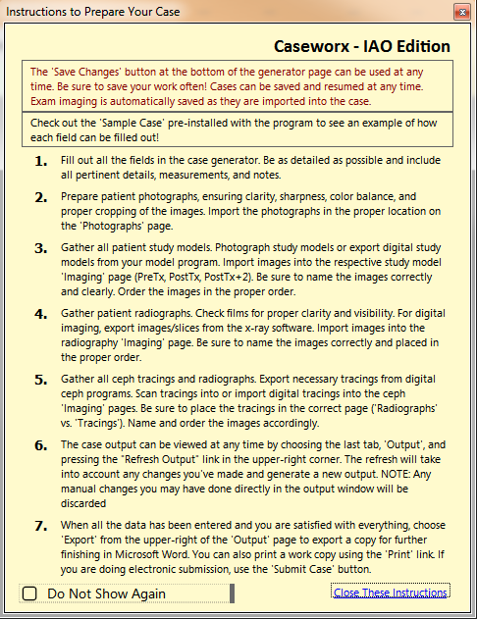
On-Screen Instructions
Shows quick list of case creation and submission process tasks
Can be hidden and shown via the “Help” -> ”Show Instructions” menu item in main screen
More detailed instructions while working available in each section

Slide 35
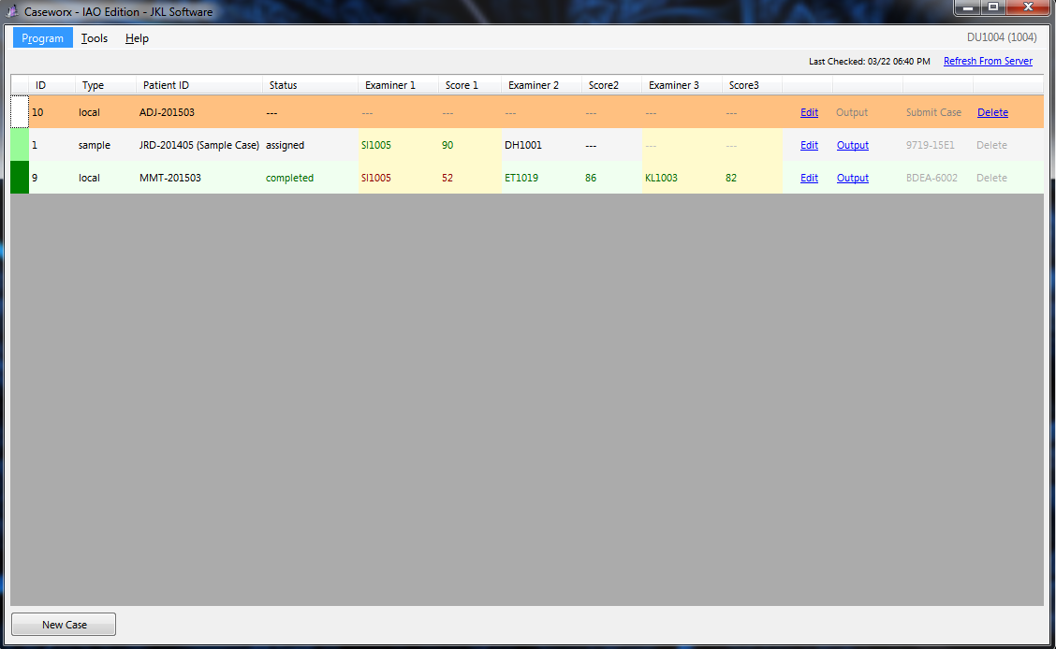
Main Screen “Home Page”
Everything starts and ends on the Home Page
Shows case status and scoring if online
Auto-updates every 15 minutes if online, manual at any time
Starts “New Case”
Can also start from “Program” menu

Slide 36
Main Screen “Home Page”
Case Type and Anonymous ID
Examiner assignments and final scores
Case Status
Assigned = submitted, in process of scoring
Holding = examiner hold
Completed = scoring completed
Functions and validations

Slide 37
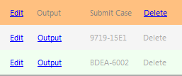
Case Functions
Case and output editor
Data editor
Image editor
Output editor
Output Viewer
Shows exactly what examiner will see
Also shows detailed score returns
Greyed out if no output saved
Delete case file
Cannot delete after submission
Cannot be undone once deleted
Submit/Resubmit case when ready
Shows validation code after submission
Greyed out if no output saved

Slide 38
Caseworx
Case Editor

Slide 39
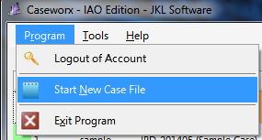
New Case Record
Started from Program menu
Also can be started from “New Case” button at lower-left of Home Page

Slide 40
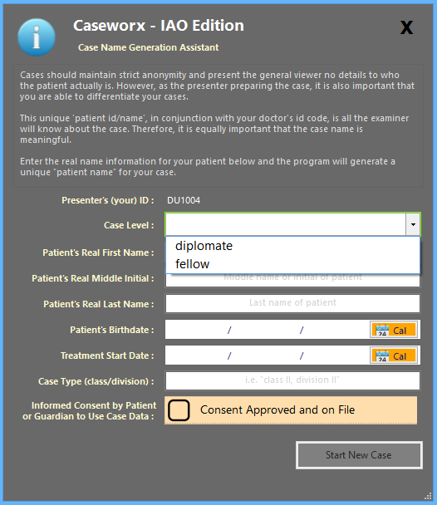
New Case Record
Generation assistant helps create consistent, unique case ID
Fellow or diplomate case choice
Fill out the info and press “Start New Case”
Preloads the case Editor with information and prepares file for generation

Slide 41
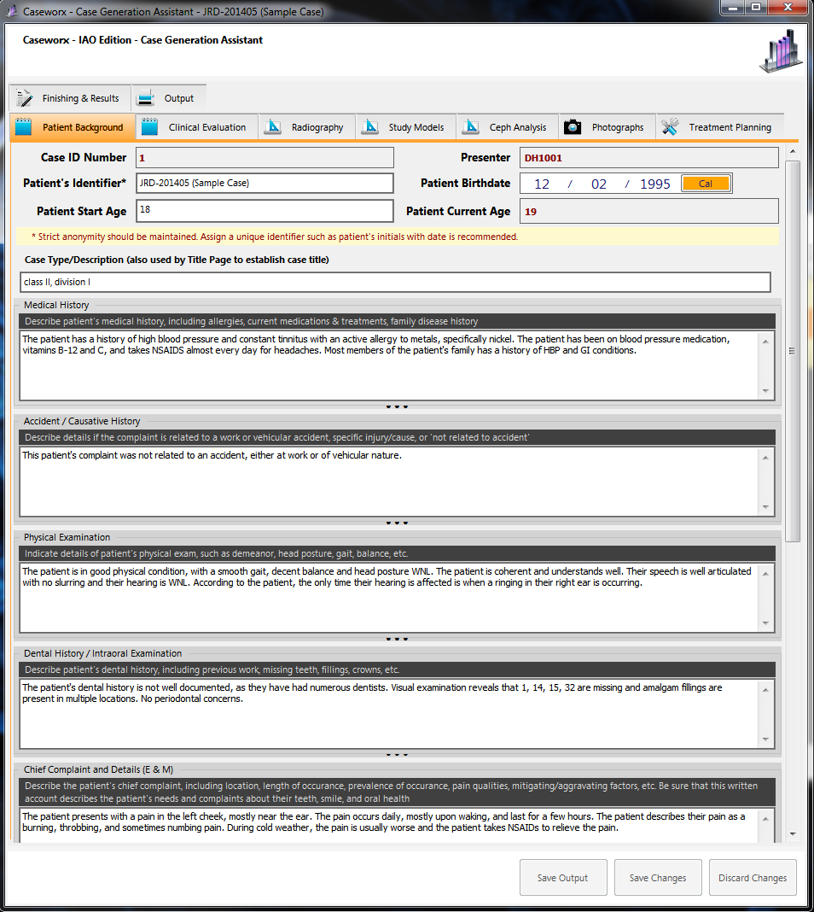
Case Generation Assistant “Editor”
Cases created/edited on this screen
Organized in logical sections
Each section contains individual boxes to enter data
Item boxes can be expanded to view more data without scrolling
Data changes can be saved (or discarded) at any time

Slide 42
Data Sections
Main section choice
Item instruction and description
Subsection
Helps organize thoughts better
May separate data from imaging panel
Item data and details

Slide 43
Saving Data
Enables when changes detected in data
Can save or discard (returns to last saved data)
Images always saved immediately
“Save Output” on enables when Output has been edited or re-generated
Can save at any time
“Save often”

Slide 44
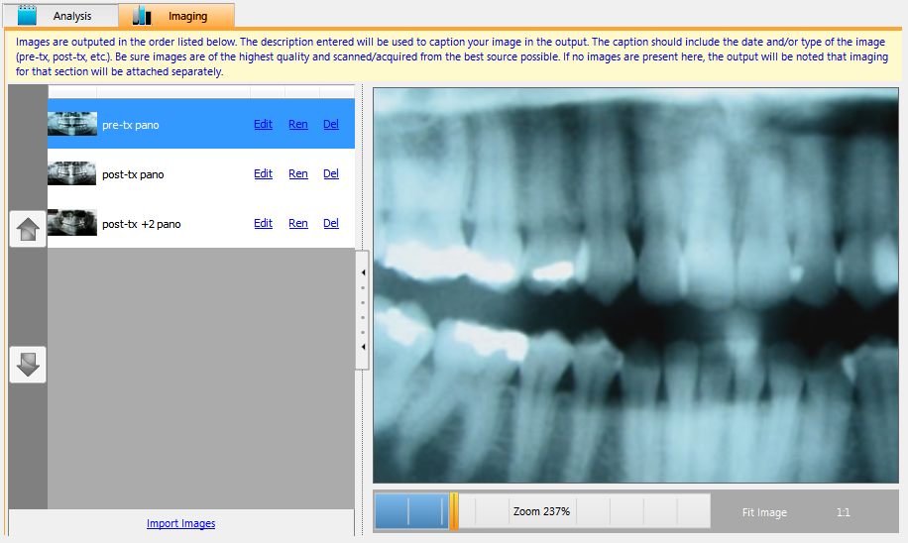
Imaging Sections
Image List and Functions
Name image appropriately
“Edit” to open image editor
Image Ordering
Images output in order listed
Use arrows to move up/down
Viewport and View Controls
Zoom image to view details
Click on image and drag to move

Slide 45
Imaging Sections
Import images
Click ‘Import Images’ link at bottom of each list
If scanning, be sure scanner is on and ready before clicking
Images saved immediately

Slide 46
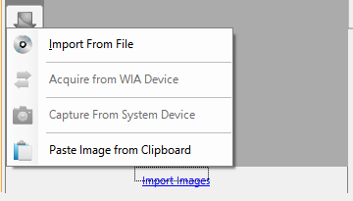
Imaging Sections
Import from File
Reads jpg, png, bmp, tiff
Scan from WIA scanner
Enables if scanner found
Paste from Clipboard
Allows any image that can be copied to the clipboard to be used

Slide 47
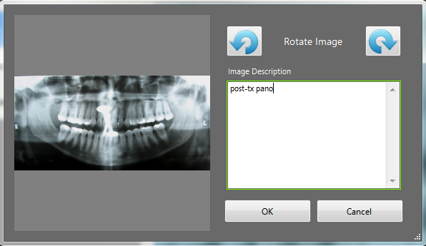
Image Importing – Import Detail
Image Preview
Quick Rotation
Detail rotation in image editor
Image Description
Used in output to describe the image

Slide 48
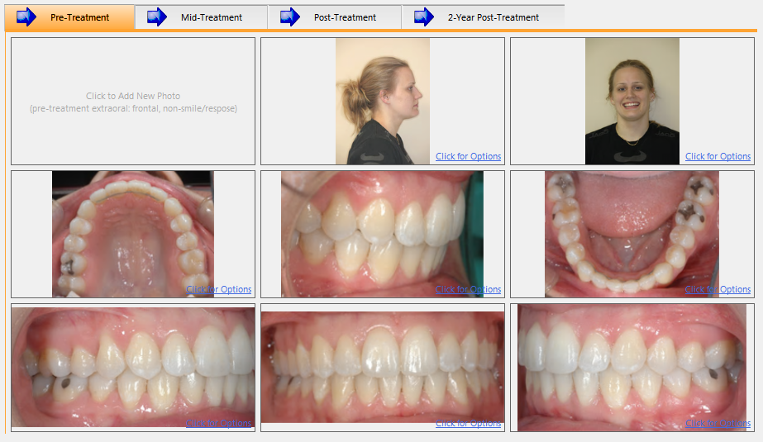
Photo Grids
Grid Selection
Empty Cell
Click to get import menu
Cell Description
Describes image that belongs in cell

Slide 49
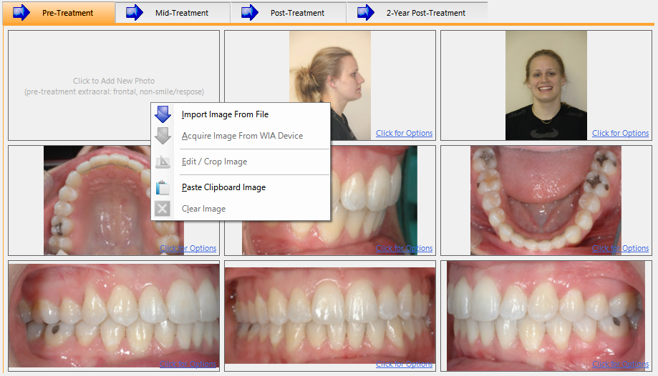
Photo Grids
Click in cell for menu
Import Menu
From file, scanner, or clipboard
Edit Menu
Click in cell with an image for replace, clear, edit options
Image changes saved immediately

Slide 50
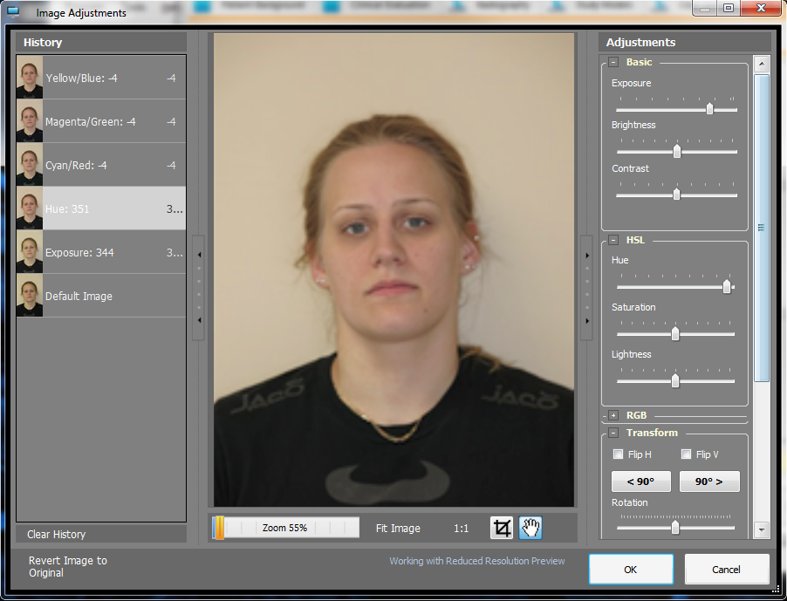
Image Editor
Change History
Adjustment Tools
Exposure, contrast, hue, and rotation most commonly used tools
Crop Tool
Can be re-edited or reverted at any time

Slide 51
Image Quality
8 megapixel is plenty, useable for up to a 24x36 print
Large files cause many issues
Long upload times for candidate, long download times for examiner
More resources to generate output, may result in out-of-memory condition
Large files show tiny flaws in image more, like camera shake
Clarity, consistency, and quality hallmark of a good image
Quality in = Quality out, cannot fix a poorly recorded image

Slide 52
Image Editor Can’t Fix Everything!
Out of focus
Sharpening doesn’t work

Slide 53
Image Editor Can’t Fix Everything!
Overexposed / blown out
Detail beyond repair

Slide 54
Image Editor Can’t Fix Everything!
Underexposed / blocked up
Brightening causes noise and blow out highlights

Slide 55
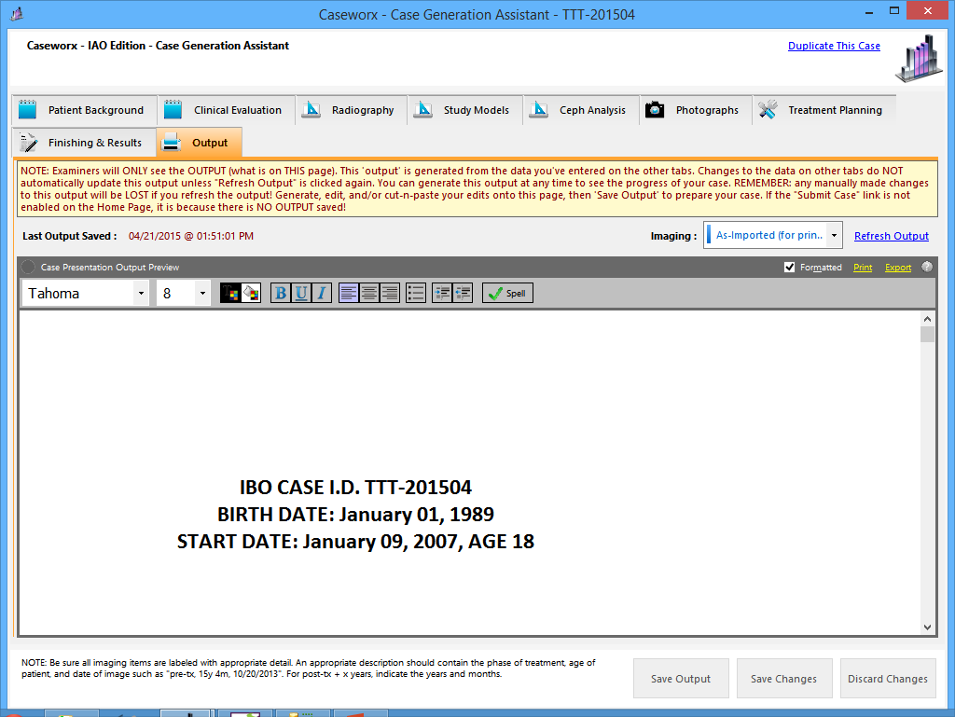
Generating Output Narrative
Last section tab
Click to generate output
Based on current data
Deletes any manual edits to previous generated output
Output preview
Used to view generated narrative
Edit final output before submission
Spell check!

Slide 56
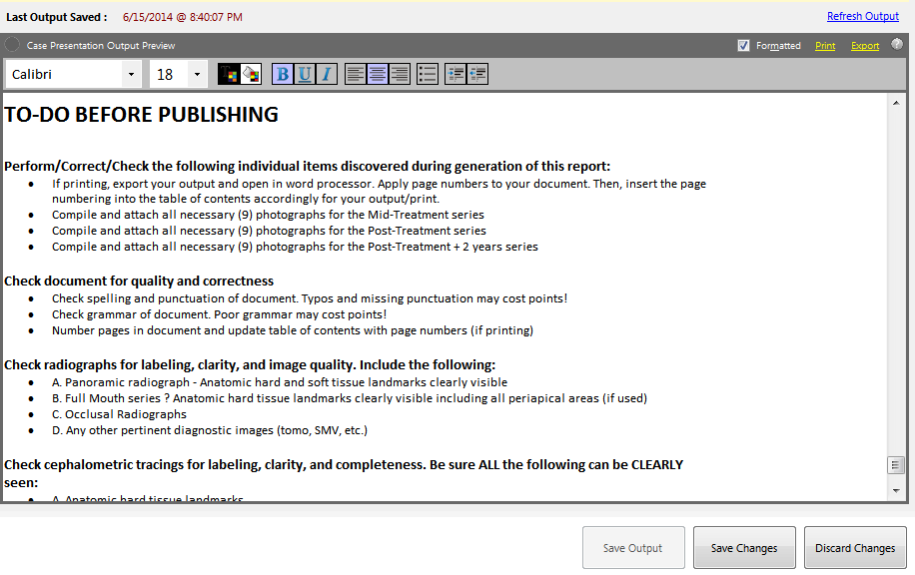
Generating Output Narrative
To-do page automatically generated at refresh time
Appears at bottom of narrative output
Check and correct missing items
Delete To-Do list before doing final save

Slide 57
Output Narrative - Hints
Avoid non-standard fonts: examiner may not have font installed on their system!
Use “Arial”, “Times New Roman”, or “Calibri” to remain standard
Remember, manual edits to output lost when refreshing from data
Best to change original source data field in appropriate section
However, can edit manually and add narrative detail before FINAL save and submission
Images fitted to page to best utilize paper orientation
Examiner will be able to view image in detail. Be sure image is saved in correct orientation in respective imaging/photo section

Slide 58
Output Narrative - Hints
No page numbering needed in table of contents
Digital submission documents don’t have “paging”
Copy/paste can also be utilized
Export document to Word document, perform further editing in Word
Return copy from Word to Output window
Ctrl-A in Word to “Select All”, Ctrl-C to Copy to clipboard
Ctrl-A in Output window to select all, Delete, then Ctrl-V to paste into Output

Slide 59
Caseworx
OUTPUT review

Slide 60
Case Functions
Case and output editor
Data editor
Image editor
Output editor
Output Viewer
Shows exactly what examiner will see
Also shows detailed score returns
Greyed out if no output saved
Delete case file
Cannot delete after submission
Cannot be undone once deleted
Submit/Resubmit case when ready
Shows validation code after submission
Greyed out if no output saved

Slide 61
Output Viewer
Exactly what the examiner will see and use for scoring
Shows last saved output, exactly as saved
Manual edits (not generated from data fields) included
No editing capabilities
Check carefully – once submitted, cannot be submitted again

Slide 62
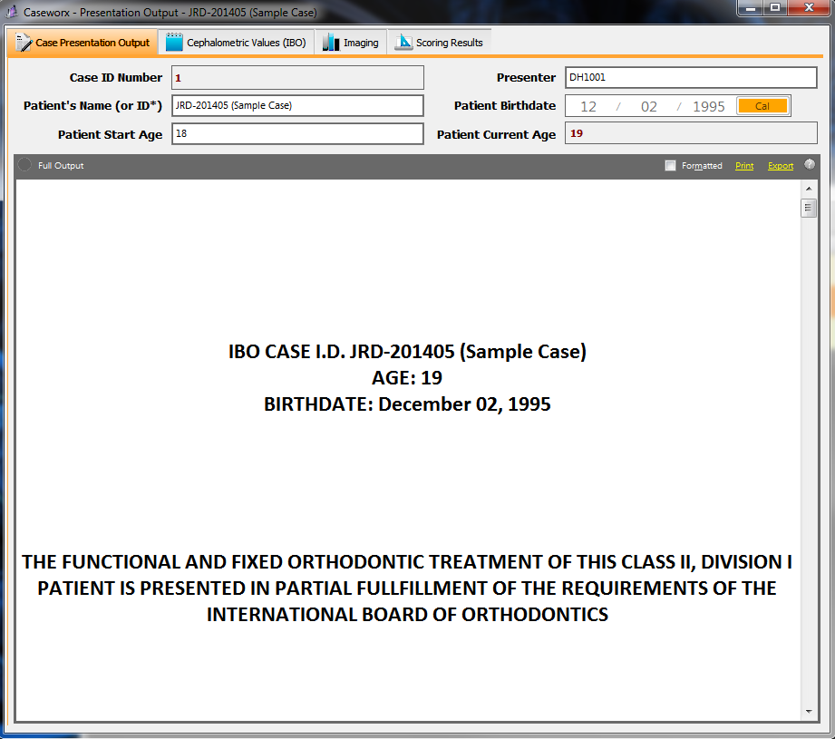
Output Viewer
Four sections to choose
Case Presentation Output
IBO Ceph value viewer
All imaging viewer
Images labeled by section/description
Scoring results
Shown only to candidates
Allows viewing details scoring results and comments from examiner

Slide 63
Output Viewer
Case details
Completely anonymous
Only shows presenter’s ID and abbreviated patient ID (generated by presenter when case created)

Slide 64
Output Viewer
Case output
Shows exact copy as last saved in editor
Cannot be changed
Includes “printable” imaging and photo grids, embedded in correct section and location

Slide 65
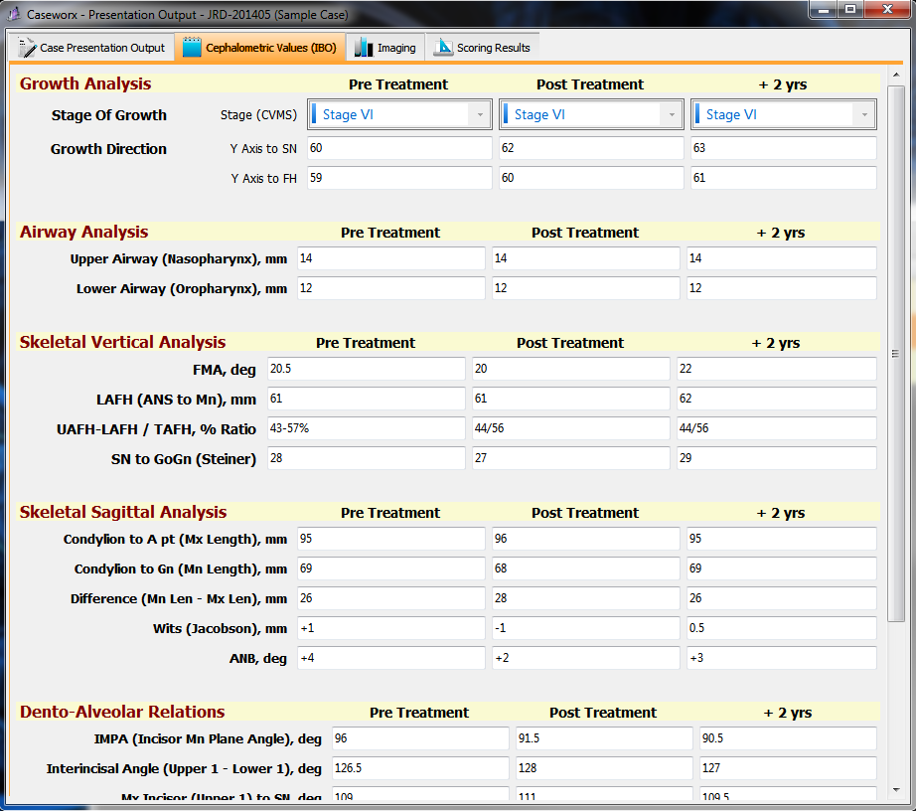
Output Viewer
IBO Ceph Sheet
Exact same as saved in editor
Cannot be changed
Check values carefully!

Slide 66
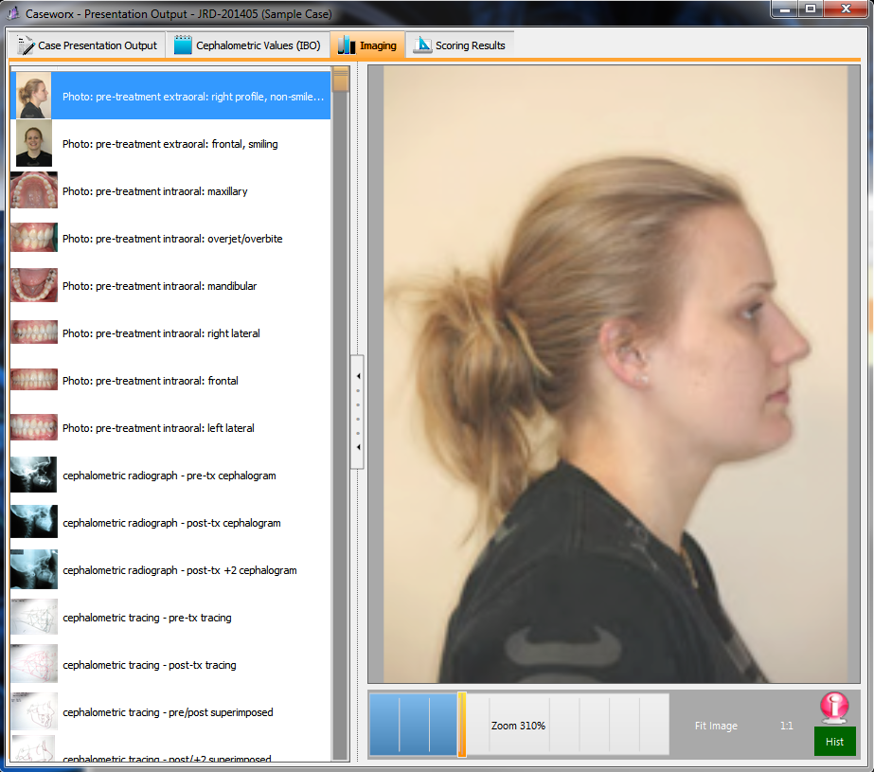
Output Viewer
Imaging Viewer
Shows all images, labeled by section and description
Imaging detailed viewport
Image modification history viewer
Enabled if image has been edited
Shows journal of changes to image

Slide 67
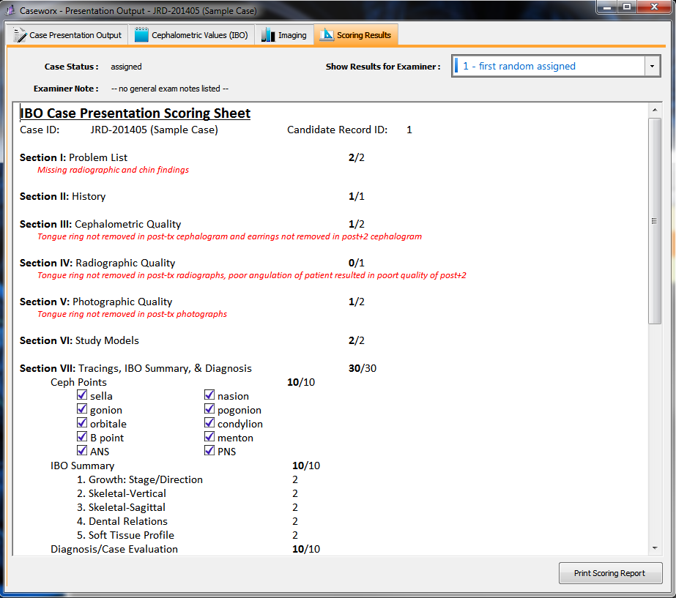
Output Viewer
Scoring Results
Only visible to candidate
Choose examiner position to show details
Examiner comments in detail for each section
Print a copy of the score sheet

Slide 68
Caseworx
Case submission

Slide 69
Case Functions
Case and output editor
Data editor
Image editor
Output editor
Output Viewer
Shows exactly what examiner will see
Also shows detailed score returns
Greyed out if no output saved
Delete case file
Cannot delete after submission
Cannot be undone once deleted
Submit/Resubmit case when ready
Shows validation code after submission
Greyed out if no output saved

Slide 70
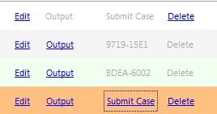
Case Submission
Available when output has been saved and logged in online
No output, cannot submit
Already submitted, has validation code from server
Has output, not submitted yet
Previously submitted, ready to re-submit case (if necessary)

Slide 71
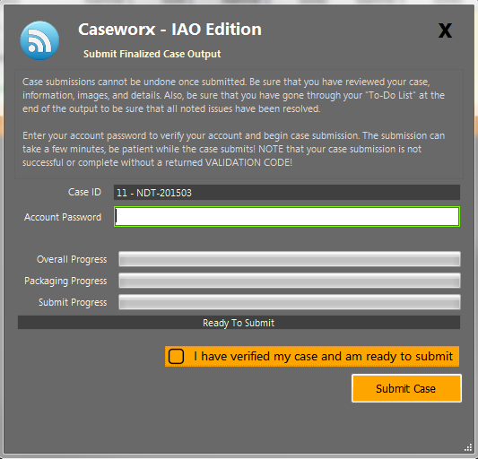
Case Submission
Enter account password and check verification box
Be sure Internet connection is reliable and consistent
Press “Submit Case” to package, encrypt, and submit case to server
Not officially accepted unless server responds with verification code (email sent!)

Slide 72
Caseworx
Scoring

Slide 73
Examiner Case Process
Acquire
Anonymous server assignment
Score
View case output
Submit
Returned to server
Detailed scoring with notes
Check in detail
Downloads output and image package
Complete score sheet

Slide 74
Auto-Case Assignment Score Basis
Two passing = Passed
Two failing = Failed
1 pass, 1 fail = third assignment
 | First Examiner Score | Second Examiner Score | Alt Examiner Score
Passed | 71 | 85 | ---
Passed | 65 | 78 | 73
Failed | 62 | 59 | ---
Failed | 73 | 59 | 68

Slide 75
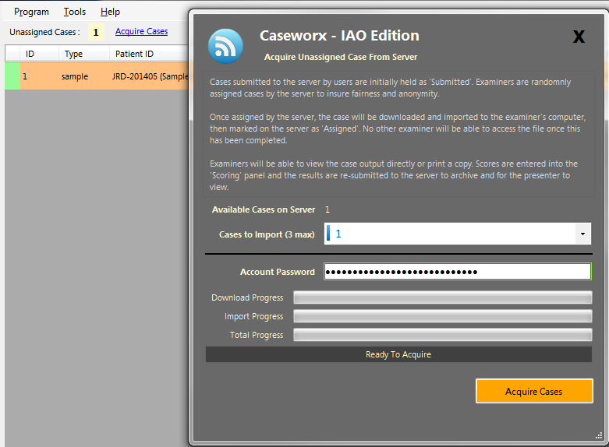
Case Assignment
No name or ID when retrieving
Server random assignment
Examiner retrieves case package as generated
Decrypted and imported to examiner’s computer

Slide 76
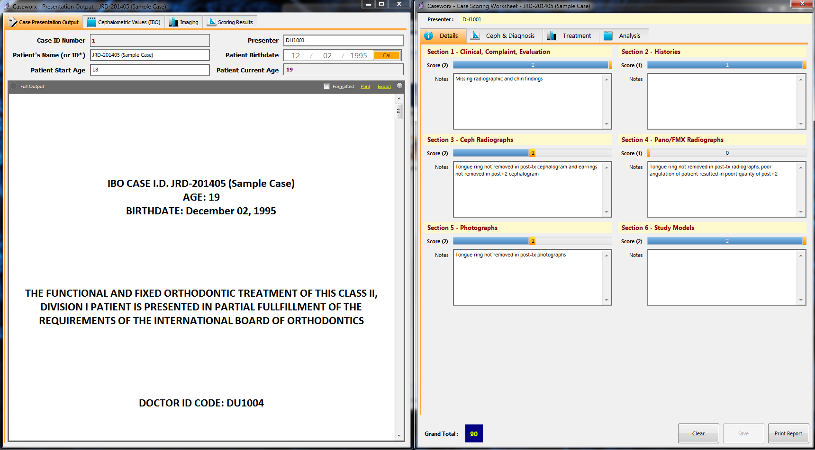
Scoring Screen

Slide 77
Scoring Screen
Examiners cannot view other scores or results
Examiners do not know who other assigned examiner(s) is/are

Slide 78
Caseworx

Slide 79
Caseworx
Download jklsoftware.com
Choose Products -> Caseworx (jklsoftware.com/caseworx)
Worldwide submission at anytime
Anonymity of case
Removes formatting errors and missed data
Concentrate on quality data
Retrieve results quickly and easily

Slide 80
JKL Software Caseworx
Nelson Mark, (nel@jklsoftware.com)
http://jklsoftware.com

